Slide 1
Airbnb Data Challenge EDA
Understand dataset
Univariate analysis
Bivariate analysis
Multivariate analysis
Notes:
Title less technical

Slide 2
Understand Dataset

Slide 3
Overview of Data
Contacts:
There are 27,887 unique inquiries with 11,588 bookings, 14 variables
Inquiries are made through 3 channels: Contact me, Book it, and Instant book
The inquiry time varies from 01/01/2016 to 06/30/2016, lead time of these inquiries ranges from 0 - 803 days
The check in dates varies from 01/01/2016 to 05/01/2018, and length of stay ranges from 1 - 365 days
Inquiries are made by either new bookers or past bookers for 1 - 16 guests
The total number of interactions between guest and host ranges from 1 - 410
Listings:
There 13038 unique listings with 4 variables
There are 3 room types for listings: Entire home/apt, private room and shared room
Listings are located in 68 neighborhoods
The number of reviews for listings ranges from 0 -268
Users:
There are 31457 users after dropping 68 duplicated ones, with 3 variables
Users are from 121 unique countries with profile length ranges from 0 - 1442

Slide 4
Sanity Check - Assumptions
Contacts
Inquiry/reply/accept/book timestamps:
ALL channels:
Inquiry time ≤ reply time ≤ accept time ≤ book time
All accepted inquiries must be replied
All booked inquiries must be accepted
Check in time ≤ check out time
Book it:
Accept time = book time
Instant book:
Inquiry time = reply time = accept time = book time
Guest size ≥ 1, total number of interactions ≥ 1, and message length ≥ 0
Listings:
Number of reviews ≥ 0
Users:
No duplicated users
Profile length ≥ 0

Slide 5
Sanity Check - Results and Treatments
Contacts
Inquiry/reply/accept/book timestamps:
ALL channels:
452 inquiries where the inquiry time > reply time with lags between 1-70 seconds
Updated the reply time to be the same as inquiry time
Book it:
257 inquiries accepted but not booked,
Updated the book time to be the same as accept time
152 inquiries where booked but not accepted or book time ≠ accepted time
Updated the book time to be the same as accept time
Instant book:
40 inquiries where inquiry, reply, accept, and booking did not happen at the same hour (allowed the latency of an hour)
Filtered out these inquiries assuming they are erroneous records

Slide 6
Sanity Check - Results and Treatments
Contacts:
Guest size:
4 inquiries where number of guests is 0:
Filtered out these inquiries assuming they are erroneous records
Listings:
Number of reviews:
41 listings with negative number of reviews:
Replaced with medium
Users:
Duplicates:
68 users with duplicate ids:
Remove from analysis

Slide 7
Merge Data
Guest information:
Merged guest information from ‘Users’ to ‘Contacts’, by ‘id_guest_anon’ in ‘Contacts’ and ‘id_user_anon’ in ‘Users’
Host information:
Merged host information from ‘Users’ to ‘Contacts’, by ‘id_host_anon’ in ‘Contacts’ and ‘id_user_anon’ in ‘Users’
Listing information:
Merged listing information from ‘Listings’ to ‘Contacts’, by ‘id_listing_anon’ in both datasets

Slide 8
Overview of Data After Cleaning
Before/After | Inquiries | Replied | Accepted | Booked
Contact me | 12,828/12,814 | 11,659/11,645 | 5,482/5,476 | 911/909
Book it | 8,366/8,352 | 7,503/7,492 | 4,240/4,237 | 3,983/3,980
Instant book | 6,693/6,682 | 6,693/6,682 | 6,693/6,682 | 6,693/6,682
Total | 27,887/27,848 | 25,855/25,819 | 16,415/16,395 | 11,587/11,571
27,848 valid inquiries were made by 22,540 unique guests
The inquiry time varies from 01/01/2016 to 06/30/2016
Inquiries were made for 12,812 unique listings of 8,956 unique hosts

Slide 9
II. Univariate Analysis

Slide 10
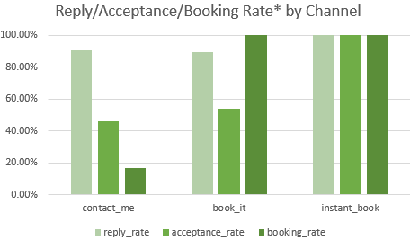
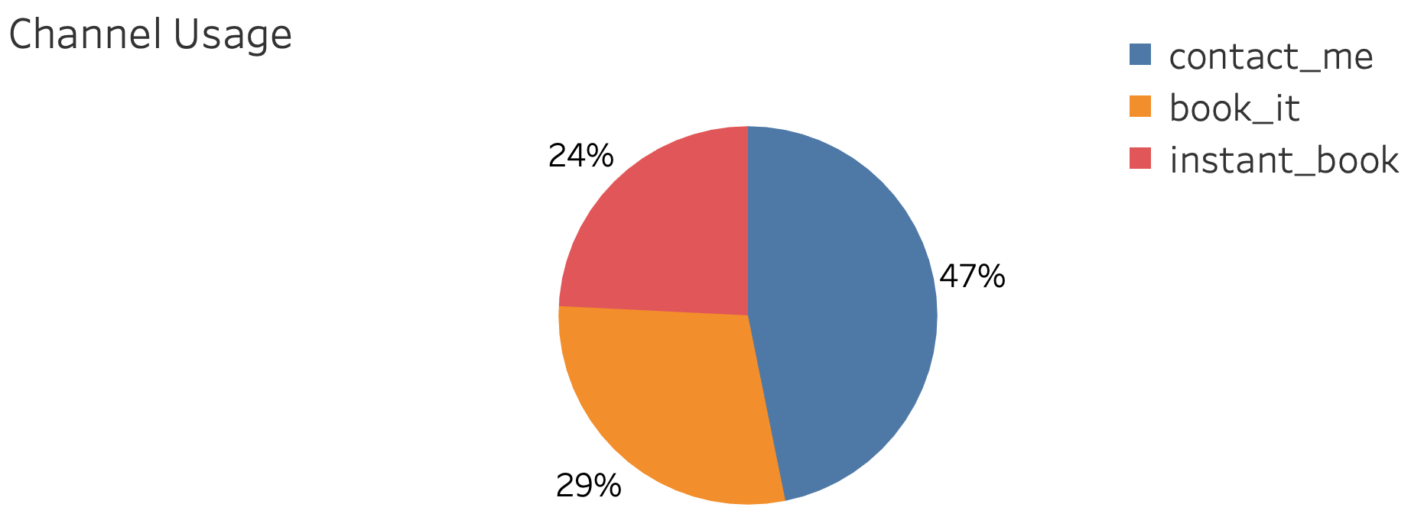
Overview of 3 Channels
Almost half (47%) of the inquiries are made through Contact Me channel
The rest of the inquiries were made in Book It (29%) and Instant Book (24%)
Contact Me and Book It does not differ much in terms of reply rate, 91% vs. 89%, and acceptance rate 46% v.s. 54%
However, Contact Me channel has a low booking rate (17%)
*Reply rate = # inquiries replied/# inquiries made, acceptance rate = # inquiries accepted/# inquiries replied, booking rate = # inquiries book/# inquiries accepted.

Slide 11
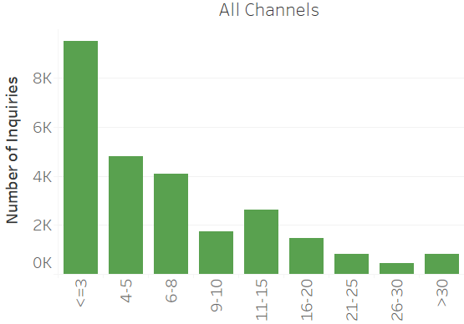
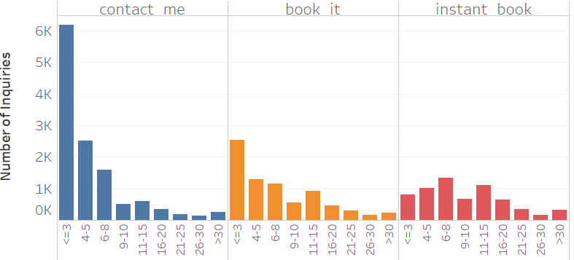
Interaction
Majority of the inquiries in Contact Me (50%) channel and Book It (33%) have no more than 3 interactions
Contact Me channel has a lower average interactions (6) than Book It (9)

Slide 12
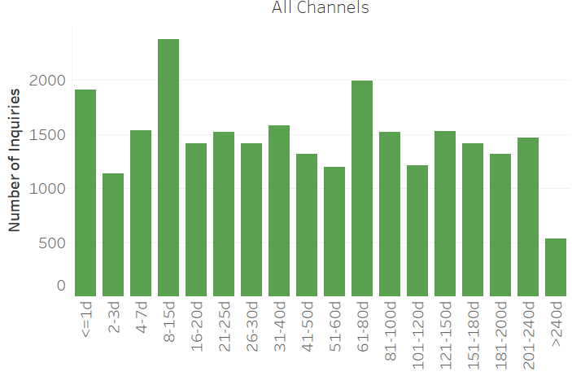
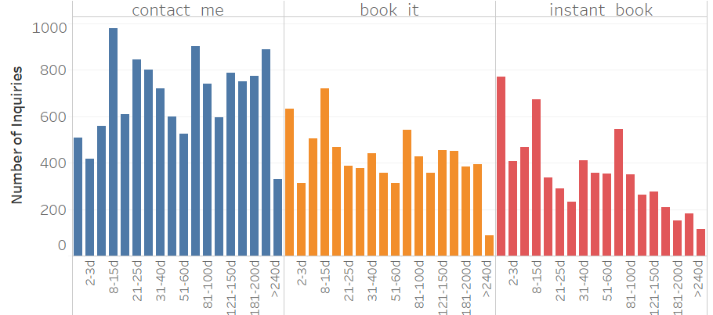
Lead time
Lead time ranges from 0 - 430 days for all inquiries, where the majority (75%) are shorter than 62 days
Contact me channel has longer lead time(82 days) and instant book has shorter lead time (55 days) on average

Slide 13
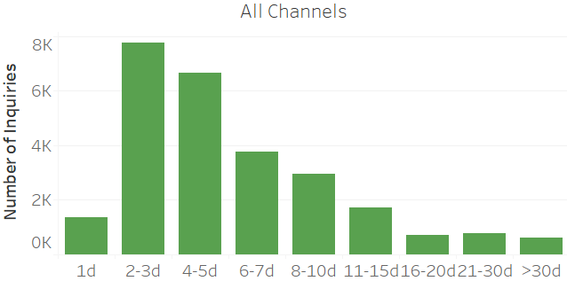
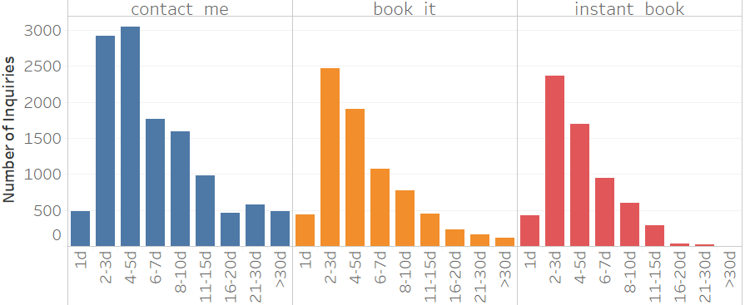
Duration of stay
The majority (55%) of the inquiries are for 2-5 days of stays for all channels
When the length of stay is longer than 15 days, this inquiry is more likely to be made in Contact Me channel as 73% of all such inquiries fall under Contact Me channel
Contact me channel has longer length of stay than other channels on average
Notes:
Change 2nd point

Slide 14
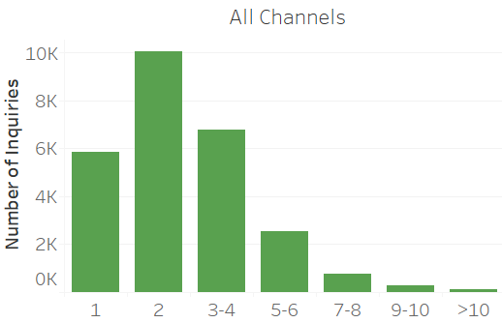
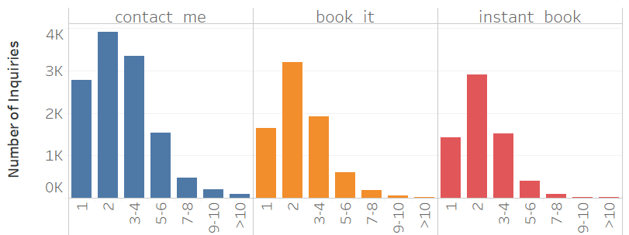
Guest size
86% of the inquiries are for no more than 4 guests and 38% of the inquiries are for 2 guests for all channels
Inquiries for 2 guests are most common for 3 channels
Contact me has higher average guest size (3) than instant book
Notes:
Add percentage to majority
Average diff

Slide 15
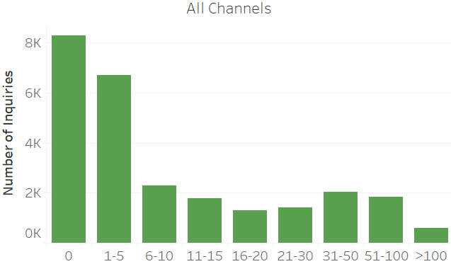
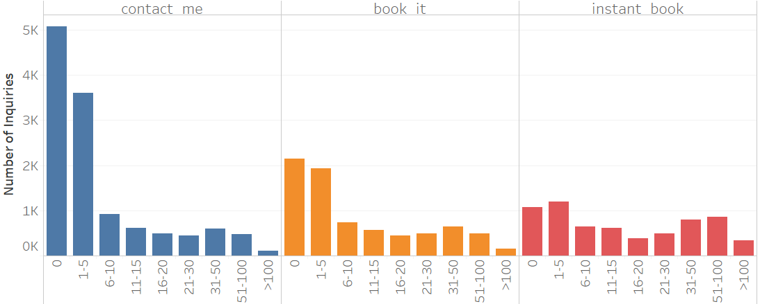
Reviews
Most (57%) of the listings have no more than 5 reviews for all channels
When a listing has no reviews, an inquiry to this listing is more likely to be made in the Contact Me channel
Listings with less than 5 reviews are most common for contact me and book it channels, whereas listings with 31 - 100 reviews are popular in instant book as well
Majority (55%) of inquiries for listings with more than 100 reviews are made in instant book channel
Inquiries made through instant book channel have more reviews on average

Slide 16
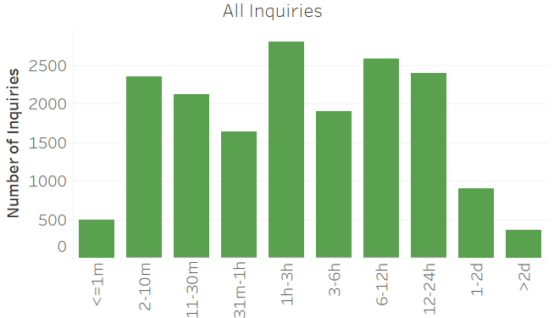
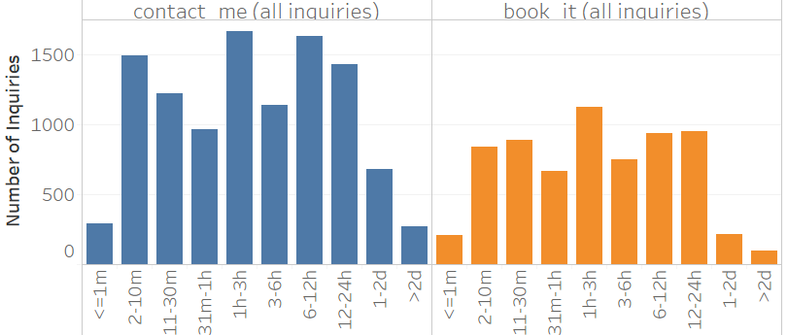
Reply time*
95% of the inquiries in both channels are replied within 1 day
14% of the inquiries are replied with in 1 - 3 hours
Longest reply time is 6 days for contact me channel 410 days for book it channel
Reply time in contact me channel is longer than book it channel on average
*Inquiries where reply time = accept time are filtered out

Slide 17
III. Bivariate Analysis (Contact Me and Book It channel only)

Slide 18
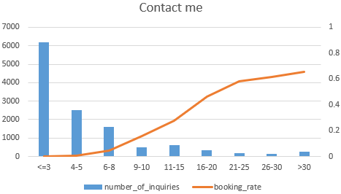
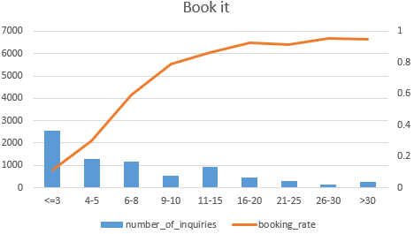
Interactions* and Booking rate
Majority (65%) of the inquiries that have no more than 3 interactions fall under Contact Me channel
More interactions are associated with higher booking rate for both channels, while the effect is stronger for book it channel
After 25 interactions for contact me channel and after 20 interactions for book it channel, the increase starts to slow down
* The dataset provided has no flag for us to differentiation when an interaction has been made, therefore interactions include interactions both before and after a booking has been made.
Notes:
2nd point: For all inquiries or successful?
Inflextion point

Slide 19
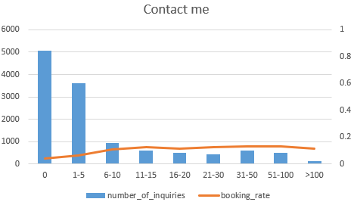
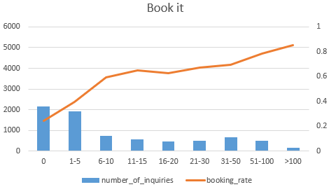
Reviews and Booking rate
70% inquiries made in contact me channel were for listings with no more than 5 reviews with booking rate less than 7%
53% inquiries made in book it channel were for listings with no more than 5 reviews with booking rate less than 40%
Having at least 11 reviews drives booking rate up to 13% in contact me channel and 65% in book it channel
Having more than 50 reviews drives booking rate up to 78% and reaches 85% when review > 100, in book it channel
However, booking rate starts to decline after 100 reviews for contact me channel
Notes:
Review more than 5 provide higher success rate for both channel, beyond that reciew positively infect

Slide 20
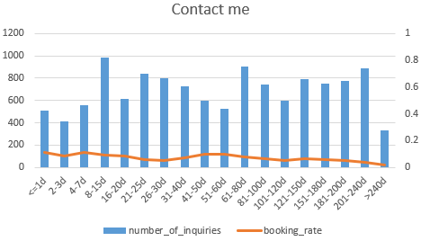
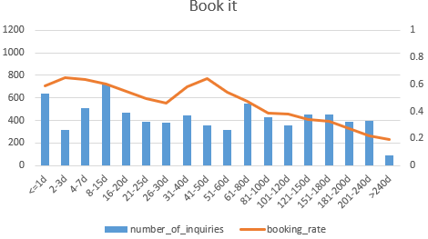
Lead time and Booking rate
27% of inquiries made within 1 day before check in are in contact me channel, and 33% in book it channel
For book it channel, inquiries made closer to checkin date have higher booking rate overall, except for inquiries made 41 - 50 days before check in, whose success rate (65%) is the same as inquiries made 2 -3 days before check in
Lead time has no strong impact on success for contact me channel

Slide 21
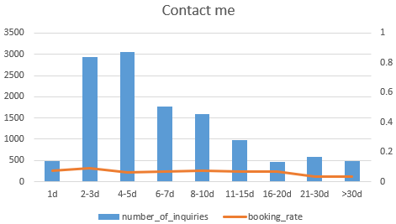
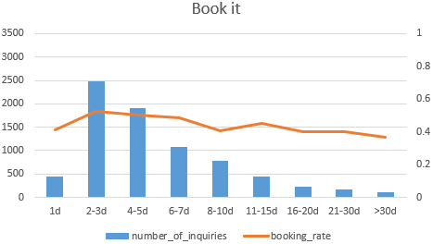
Duration of stay and Booking rate
The majority (61%) of trips longer than 7 days are in contact me channel
Trips of 2 or 3 days are most likely to be booked for both channels
The longer the stay, the lower the success rate for Book it channel
Success rate starts to decline when trips are longer than 7 days for book it channel

Slide 22
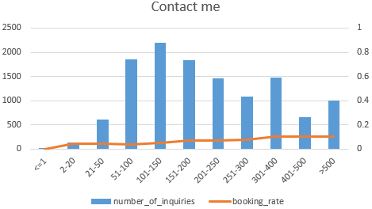
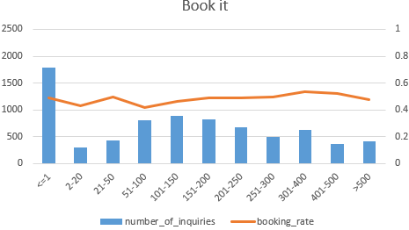
Message length and Booking rate
18% of the inquires in contact me channel contains 100 -150 characters, 23% of the inquiries on book it channel contains less than 1 characters
Longer(>50 characters) messages tend to be sent in contact me channel, short (<20 characters) tend to be sent in book it channel
Longer messages are associated with higher booking rate for contact me channel, but the increase is slow
For book it channel, messages with either 20 - 50 or 300 - 400 characters are most likely to be booked, otherwise there is not a obvious trend between message length and booking rate

Slide 23
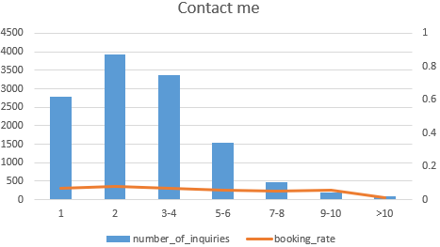
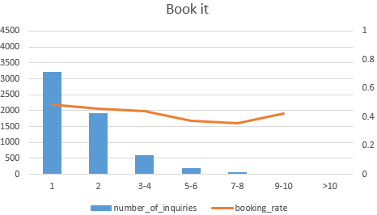
Guest size and Booking rate
The majority (36%) of single guests chose book it channel, whereas contact me channel dominates over other guest sizes
Inquiries for single guest have the highest success rate for in book it channel
More guests are associated with low booking rate for both channels

Slide 24
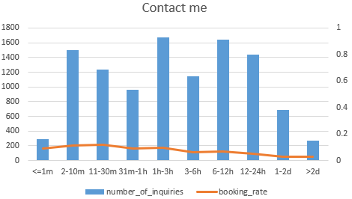
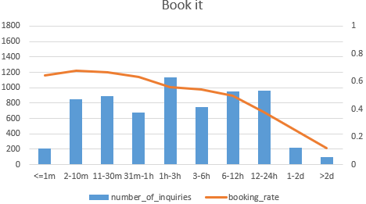
Reply time* and Booking rate
Contact me channel dominates over all reply time bins
Longer reply time is associated with lower booking rate for both channels, whereas the decrease is much stronger in book it channel
Inquiries replied within 30 mins are most likely to be booked for both channels
In book it channel, replies time longer than 1 hour drags booking rate below 70%, those longer than 12 hours drags booking rate below 50%
*Inquiries where reply time = accept time are filtered out

Slide 25
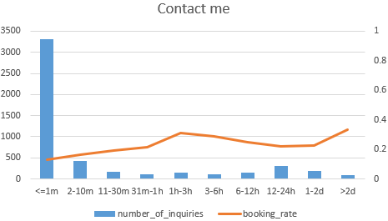
Accept time v.s. Booking rate
For contact me channel, inquiries accepted within 1-3 hours after reply are most likely to be booked
Longer accept time tends to drive up the booking rate, longer accept time might could mean that the host spent more time to interact with the guest before accepting the request and therefore guests are more likely to make the booking

Slide 26
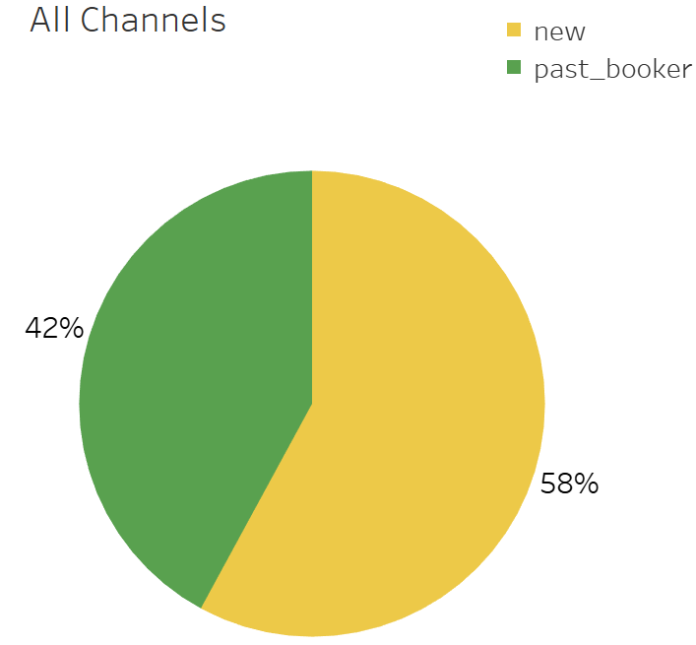
User stage and Booking rate
[# of inquiries] reply/accept/book rate* | Contact Me | Book It | Instant Book
New Booker | [8,793] 91%/46%/15% | [4,296] 89%/52%/100% | [2,802] 100%/100%/100%
Past Booker | [4,005] 90%/47%/22% | [4,050] 90%/56%/100% | [3,881] 100%/100%/100%
The majority (56%) of new users tend to choose contact me channel
Reply rate does not differ much between new and past booker among 3 channels
Accept rate of past bookers is slightly higher than new bookers for Contact Me and Book It channel
Book rate of past bookers is 47% higher than new booker (22% v.s. 15%) in Contact Me channel
*Reply rate = # inquiries replied/# inquiries made, accept rate = # inquiries accepted/# inquiries replied, book rate = # inquiries book/# inquiries accepted.

Slide 27
IV. Multivariate Analysis (Contact Me and Book It channel only)

Slide 28
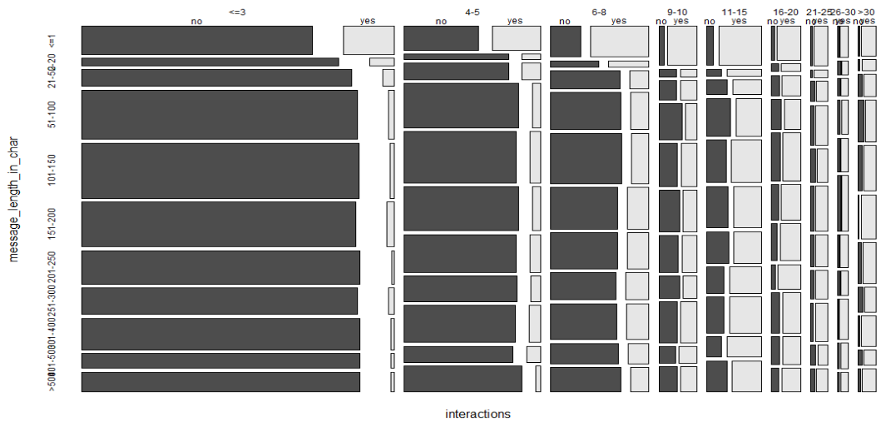
Message + Interaction
Regardless of message length, when # of interactions >11, it will lead to more bookings than non booking.
When # of interactions > 11, it can make up for the lack in message length, and turn an inquiry into a successful booking.
When message length is >20, more interactions are needed in order to turn an inquiry into a successful booking. This could be due to the fact that a longer message reflects the complexity of a stay request, therefore needing more interactions between the host and the guest in order for it to be successful.

Slide 29
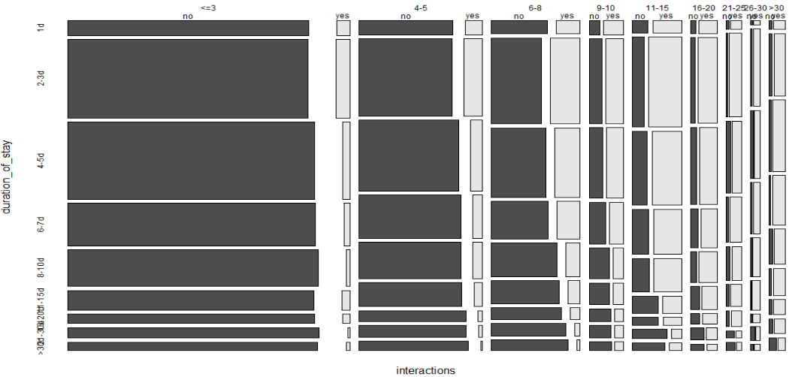
Duration of stay + Interaction
Days of stay ≤ 3 regardless of number of interactions, will lead success rate to double
However, when number of interactions is more than 20, it no longer matters how long the stays are, which means, more than 20 interactions might be able to sufficiently make up for the long stays.

Slide 30
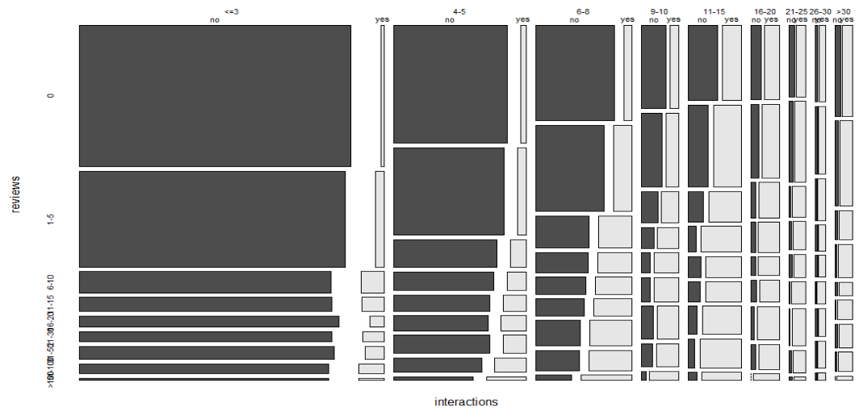
Review + Interaction
Number of reviews > 5, regardless of number of interactions, will double the success rate
However, when number of interactions is more than 20, it no longer matters when an inquiry has fewer or more than 5 reviews, which means, more than 20 interactions might be able to sufficiently make up for the lack of reviews.

Slide 31
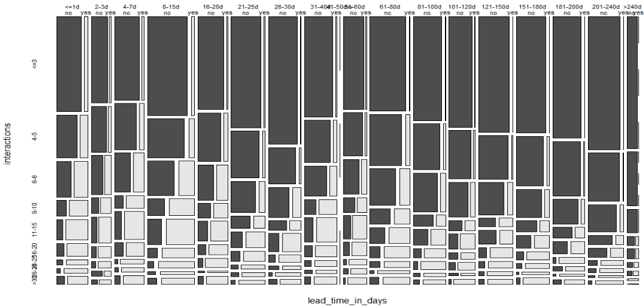
Interaction + Lead time
When lead time ≤ 15 days, the number of successes doubled regardless of interactions
Regardless of lead time, when # of interactions >11, it will lead to more bookings than non booking. Therefore, having more than 11 interactions can make up for the long lead times, and turn an inquiry into a successful booking.

Slide 32
Key metrics to monitor success
Reply/accept rate/book rate
Reply rate = # inquiries replied/# inquiries made
Accept rate = # inquiries accepted/# inquiries replied
Book rate = # inquiries book/# inquiries accepted
These metrics help track the success rate of each step that an inquiry takes to turn into a booking
Average interactions per inquiry
Avg interactions per inquiries = # interactions / # inquiries
Analysis results indicate that inquiries with more interactions are more likely to be booked across all channels
Average number of reviews per listing
Avg # reviews per listing = # reviews / # listings
Analysis results indicate that inquiries with more interactions are more likely to be booked across all channels

